Slide 1

Trends in Child Stunting: Analysis of
NFHS-4 Data

Slide 2
MOTIVATION
Child stunting, characterized by low height for age, is a critical indicator of child health and development. Despite improvements in child health indicators globally, stunting remains a significant public health concern, particularly in low- and middle-income countries.
This project aims to analyze and predict the prevalence of child stunting using data from the NFHS-4, focusing on understanding the impact of various factors such as sanitation, maternal health, socioeconomic status, and demographic variables.

Slide 3
OBJECTIVES
The objective of this project is to leverage the rich data from NFHS-4 to gain a deeper understanding of trends in child stunting and the factors contributing to those trends.
Generate knowledge about child stunting that can inform the development and implementation of targeted strategies to reduce its prevalence.
Contribute to the existing body of knowledge on child health and development, emphasizing the importance of sanitation, women's health during pregnancy, and education in child health outcomes.

Slide 4
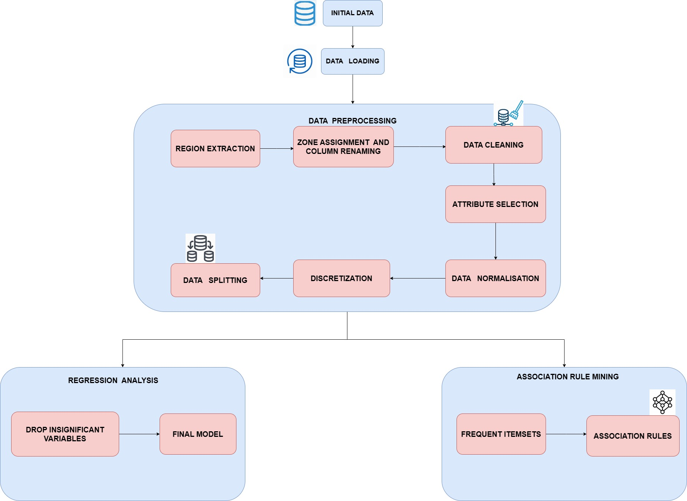
ARCHITECTURE DIAGRAM

Slide 5
METHODOLOGIES
Data Acquisition:
Obtain the NFHS-4 dataset, which is likely publicly available from a government.
Data pre-processing:
Data Cleaning: Remove errors and missing values.
Data Normalization: Ensure all variables use a similar scale.
Binning: Divide data points into equal frequency groups.
Data Analysis:
Regression:
This statistical method can be used to model the relationship between child stunting (dependent variable) various factors (independent variables) from the NFHS-4 data.
Association Rule Mining (ARM):
Apriori algorithm is used to identify frequent patterns of factors that often co-occur with child stunting.

Slide 6
METHODOLOGIES
Data Visualization:
Visualisation techniques like histogram, scatter plot were used to discover relationships between factors of child stunting.
Platform used:
Google Colab
Language :
Python
Libraries:
pandas
numpy
matplotlib
seaborn
statsmodels

Slide 7
IMPLEMENTATION
The implementation began with parsing and cleaning the data by adding 'Region' based on district names and mapping states to predefined 'Zone' values.
We then engineered features, dropping irrelevant and highly correlated columns.
Data transformation involved Z-Score normalization for standardization and discretization using both Equal Interval and Equal Frequency binning methods.
The processed datasets were exported as new CSV files for further analysis.
The statsmodels library was used to build the regression models.
Defining a list of the 19 variables and create arrays for independent (features) and dependent (target) variables.
.

Slide 8
IMPLEMENTATION
Defining two linear regression models:
The first model likely used all features initially.
The second model likely used a reduced set of features after removing non-significant ones from the first model.
Fitting the models to the data and obtaining coefficients for each variable and Printing the model summaries to analyze the results
Mines association rules uses the Apriori algorithm to discover frequently occurring combinations of factors and how they relate to high stunting.
Extracts interesting patterns: Focuses on frequent itemsets and rules that specifically predict high stunting in children under 5.

Slide 9
RESULT FOR REGRESSION ANALYSIS
Positive Corelation with Child Stunting | Negative Corelation with Child Stunting
Population(female) age 6+ years who never attended school(%) | Sex ratio of the total population (females per 1000 males)
Households with an improved drinking water source(%) | Households using improved sanitation facility2 (%)
Women whose Body Mass Index (BMI) is below normal (BMI 18.5 kg/m^2)(%) | Households using clean fuel for cooking3 (%)
Women age 20-24 years married before age 18 years (%) | Women who are literate (%)
 | Total children age 6-23 months receiving an adequate diet9 10 (%)
 | All women age 15-49 years who are anaemic (%)
 | Any modern method (%)
 | Mothers who had at least 4 antenatal care visits (%)

Slide 10
RESULT FOR ASSOCIATION RULE MINING
Antecedent Attributes | Consequent Attribute | Confidence
72. Women BMI below normal (%) high' | ‘68.Children under 5 stunted (%)high’ | 0.633
12.Women literate(%) low’ | ‘68.Children under 5 stunted (%)high’ | 0.647
‘8.Improved sanitation (%) low’ | ‘68.Children under 5 stunted (%)high’ | 0.684
72. Women BMI below normal (%) high'12.Women literate(%) low’ | ‘68.Children under 5 stunted (%)high’ | 0.763
12.Women literate(%) low’ ‘9.Clean fuel for cooking(%)low’ | ‘68.Children under 5 stunted (%)high’ | 0.743
’13.Men literate(%) low’.’12.Women literate(%)low’ | ‘68.Children under 5 stunted (%)high’ | 0.707
15.Women married before 18(%)high’,’12.Women literate(%)low’ | ‘68.Children under 5 stunted (%)high’ | 0.688

Slide 11
Antecedent Attributes | Consequent Attribute | Confidence
72. Women BMI below normal (%) high'‘8.Improved sanitation (%) low | ‘68.Children under 5 stunted (%)high’ | 0.745
’13.Men literate(%) low’.‘8.Improved sanitation (%) low | ‘68.Children under 5 stunted (%)high’ | 0.763
8.Improved sanitation (%) low’ ‘9.Clean fuel for cooking(%)low’ | ‘68.Children under 5 stunted (%)high’ | 0.732
8.Improved sanitation (%) low’ , 12.Women literate(%) low’ | ‘68.Children under 5 stunted (%)high’ | 0.778
15.Women married before 18(%)high, 8.Improved sanitation (%) low’ | ‘68.Children under 5 stunted (%)high’ | 0.786
32.Pregant women took iron folic acid for 100+ days(%) low’, 12.Women literate(%) low’ | ‘68.Children under 5 stunted (%)high’ | 0.724
32.Pregant women took iron folic acid for 100+ days(%) low’, 8.Improved sanitation (%) low’ | ‘68.Children under 5 stunted (%)high’ | 0.813

Slide 12
CONTRIBUTION
NAME | CONTRIBUTION
MADHUMITHA PS | Worked in Data Collection, Implemented Pre-processing module-cleaning, Normalization, Binning. Literature survey, Data description, data pre-processing steps in Overleaf. Presentation.
SHALINI R | Worked in Association rule Mining. Data Analysis Methods, Proposed work Part In overleaf, Presentation
HARISHMA SABU | Worked in Regression Analysis, Architecture Diagram, data Visualization part in overleaf, Presentation.

Slide 13
REFERENCES
[1] R. Rahutomo, G. N. Elwirehardja, M. Isnan, F. Asadi and B. Pardamean, ”Machine Learning Implementations in Childhood Stunting Research: A Systematic Literature Review,” 2023 International Conference on Infor mation Management and Technology (ICIMTech), Malang, Indonesia, 2023, pp. 229-234, doi: 10.1109/ICIMTech59029.2023.10277881.
[2] A. Hermanto et al., ”Prediction of Nutritional Requirements for Chil dren’s Growth and Adolescents using Machine Learning,” 2022 Inter national Seminar on Application for Technology of Information and Communication (iSemantic), Semarang, Indonesia, 2022, pp. 263-267, doi: 10.1109/iSemantic55962.2022.9920443.
[3] M. Zarlis, T. Oktavia, R. Buaton, F. Ernawan and K. Andrian, ”Minimiz ing the Number of Stunting Prevalence Using the Euclid Algorithm Clus tering Approach,” 2023 International Conference of Computer Science and Information Technology (ICOSNIKOM), Binjia, Indonesia, 2023, pp. 1-7, doi: 10.1109/ICoSNIKOM60230.2023.10364489.
[4] R. A. Rahma, U. Dayati, E. S. Desyanty and R. A. Listyaningrum, ”Development of a Technology-Based Parenting Support Center Model to Support Stunting Reduction Programs,” 2022 8th International Con ference on Education and Technology (ICET), Malang, Indonesia, 2022, pp. 177-184, doi: 10.1109/ICET56879.2022.9990871.
[5] R. Joseph, V. Sawant, S. Shenai, M. Paryani and G. Patil, ”Machine Learning based Factors affecting Malnutrition and Anemia among children in India,” 2022 6th International Conference on Intelligent Computing and Control Systems (ICICCS), Madurai, India, 2022, pp. 1826-1833, doi: 10.1109/ICICCS53718.2022.9788386.

Slide 14
REFERENCES
[6] S. Jain, T. Khanam, A. J. Abedi and A. A. Khan, ”Efficient Machine Learning for Malnutrition Prediction among under-five children in India,” 2022 IEEE Delhi Section Conference (DELCON), New Delhi, India, 2022, pp. 1-10, doi: 10.1109/DELCON54057.2022.9753080.
[7] Z. Momand, P. Mongkolnam, P. Kositpanthavong and J. H. Chan, ”Data Mining Based Prediction of Malnutrition in Afghan Chil dren,” 2020 12th International Conference on Knowledge and Smart Technology (KST), Pattaya, Thailand, 2020, pp. 12-17, doi: 10.1109/KST48564.2020.9059388.
[8] J. Chen, R. Soangra, M. Grant-Beuttler, Y. A. Nanehkaran and Y. Wen, ”Dense Attention Convolutional Neural Networks for Toe Walking Recognition,” in IEEE Transactions on Neural Systems and Rehabilitation Engineering, vol. 31, pp. 2235-2245, 2023, doi: 10.1109/TNSRE.2023.3272362.
[9] S. E S, G. N. Sundar and D. Narmadha, ”An Investigation on Impact of Malnutrition in Human Health and Technique to Evaluate the Nutrient Intake from the Food Image,” 2022 IEEE International Power and Renewable Energy Conference (IPRECON), Kollam, India, 2022, pp. 1-5, doi: 10.1109/IPRECON55716.2022.10059560.
[10] S. Bonaldo, F. Dal Lago, G. Putoto, L. Dal Lago, E. Griggio and A. Paccagnella, ”Portable Digital Stadiometer for Assessing the Degree of Childhood Malnutrition in Low-Income Countries,” 2021 IEEE Interna tional Humanitarian Technology Conference (IHTC), United Kingdom, 2021, pp. 1-8, doi: 10.1109/IHTC53077.2021.9698950

Slide 15
THANK YOU

